Slide 1
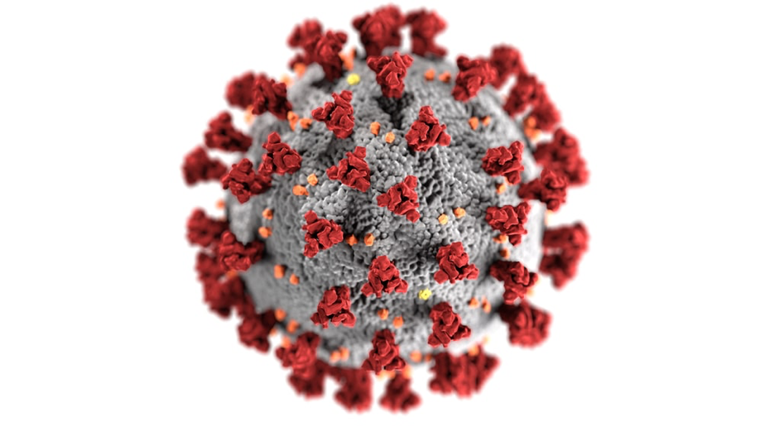
Zero Kode Covid-19 calculate the risk

Slide 2
Problem Definition
Young people need a way to go back to their daily routine, while at the same time being careful about covid-19 and its new variants, in the face of the slow vaccination process.

Slide 3
User Profile
Young people that wish to go out to social encounters
Demographic characterization: Young people are usually students that have an active social live and want to go out on social encounters with their friends on a weekly basis
Main chores: most of them study, maybe they have a job or have to take care of their brothers and the house
Pains they go through: not being able to go out on social encounter due to their parents not knowing whether it is safe for them to do so
Benefits they seek: to be able to go out on social encounters with their friends without risking catching COVID

Slide 4
Design Principles
The solution integrates risk statistics about the area in which the user is located
The solution integrates ways to recommend safety measures to the user based on the risk level in their area

Slide 5
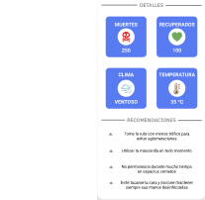
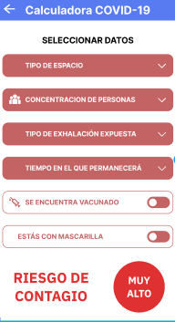
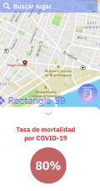
Prototype

Slide 6
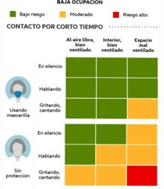
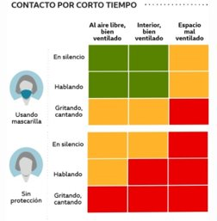
Parameters for measuring infection risk
High and low people flow
https://www.bmj.com/content/370/bmj.m3223

Slide 7
Thank you!

